Slide 1
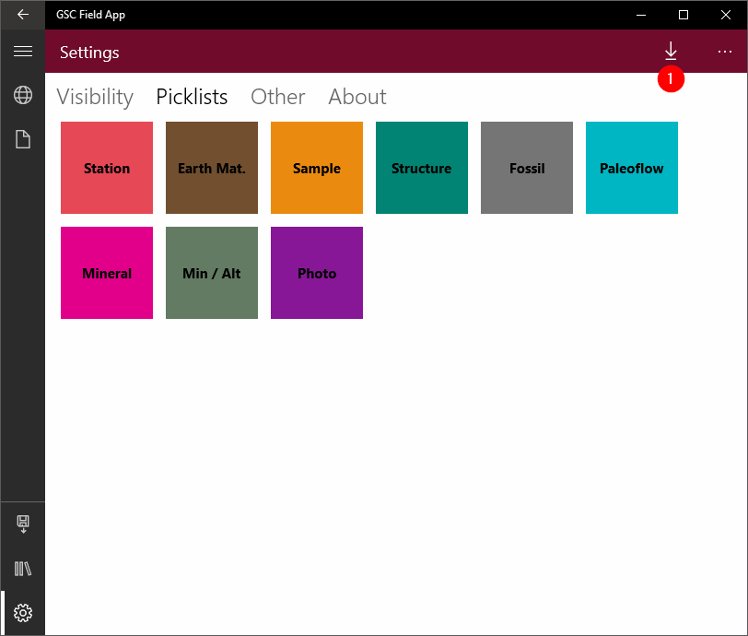
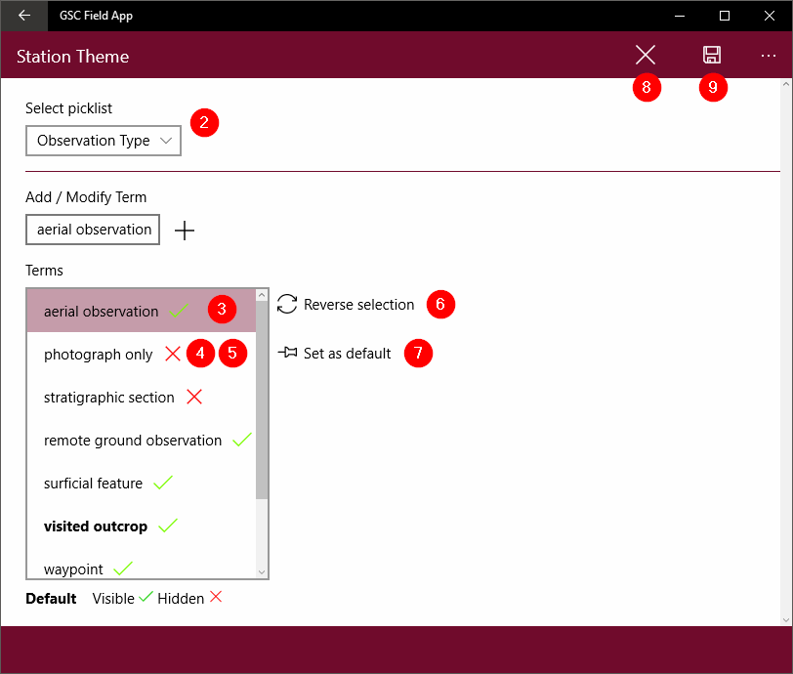
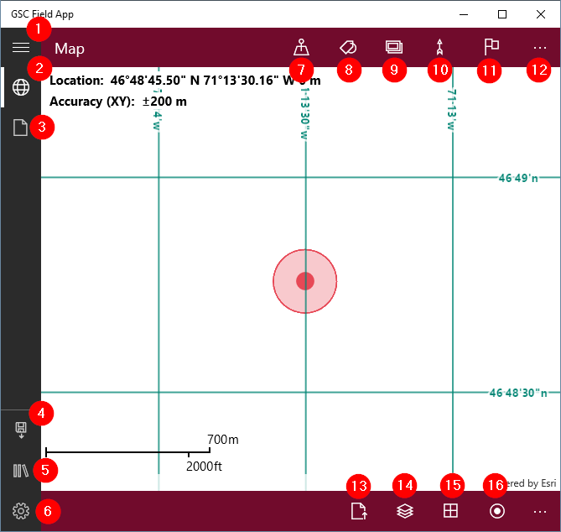
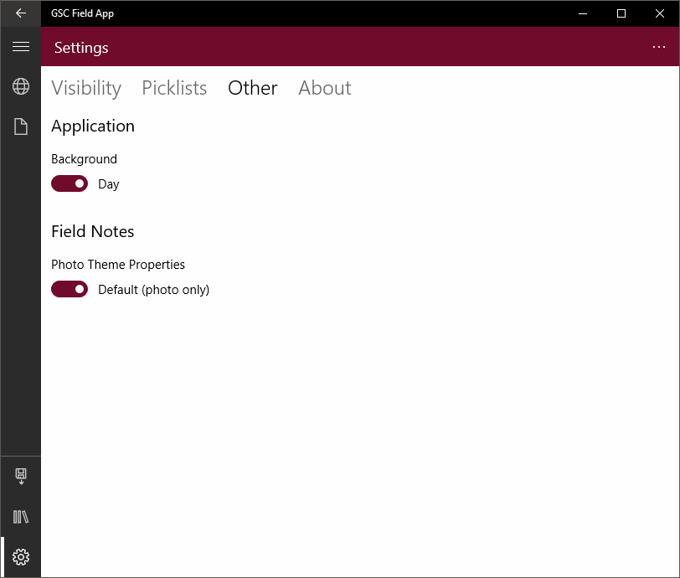
Settings - Picklists
GSC FIELD APP GUIDE
Application navigation / Map page
Navigation Pane → Summary of application pages.
Navigation button: Expands/minimizes the side navigation bar.
Map button: Navigates to map page.
Field notes button: Navigates to field notes page.
Backup button: Backup data to a custom location.
Field books button: Navigates to field books page.
Setting button: Navigates to application settings page.
Map Header→ Quick tools that acquire a GPS location and
popup appropriate information dialogs.
Station: Opens a dialog to enter current visit information.
Sample: Opens a dialog to enter any sample related information. An empty station record will also be created.
Picklists → Allows the user to customize the picklists. Click/tap on a theme to open the picklist editor dialog box.
Load picklist: Load a picklist that comes from an external database (an SQLite file). This is a convenient tool to deploy the same picklists in all devices of the same project.
Picklist editor → Enables editing of picklists from a selected theme of records (stations, earth material, etc.)
Select picklist: Drop-down menu of available picklists for the selected theme.
Green checkmark: Indicates values set as visible. A click/tap will set it to hidden and show a red x.
Red X: Indicates values set as hidden. A click/tap will set it to visible and show a green checkmark.
Reordering: Select and drag a value up or down the list to set the order of appearance in the picklist.
Reverse selection: Reverse visibility/hidden properties of selected values. Hidden values become visible and visible values become hidden.
Set as default: Set the default value of the field associated with the selected picklist. This is a convenient tool to speed up data entry when a specific value is selected in most of the cases.
Close/Exit: Close the dialog without any save. Any modifications will be lost.
Save: Save changes and close the record.
Photo: Opens a dialog to enter photo-related information. An empty station record will also be created.
Measure: Opens a dialog to enter structure-related information. Empty station and earth material records will also be created (an earth material can have multiple related measurements).
Waypoint: Opens a waypoint dialog to enter brief notes. A waypoint is only a GPS location with a single note option. It can be used to enter observation between stations or to locate and describe drop bags location site.
Ellipsis: Enable/Disable top bar expansion, showing icon text.
Map Footer → Tools to interact with map content.
Add Layers: Adds a read-only background layer (.tpks) or databases (.sqlite).
Layers: Opens a fly-out menu that shows loaded layers. Each one can be toggled ON/OFF, reordered, deleted and have its transparency set.
Info: Disables/enables map content information like background grid lines, current coordinates and map scale.
GPS Mode: Disble/Enable GPS
Disabling GPS will enable user to enter quick information (top bar) with a tap on the map content.
Map Content → Shows current location, added maps and other GIS-related information.
Center colored dot: Current GPS location.
Circle around dot: Visual accuracy of the current GPS location. A wider circle indicates a less accurate coordinate. Circle is to scale based on accuracy. Red color means a poor accuracy of 40 meters and higher, yellow means a tolerable accuracy between 20 and 40 m, and green means a good accuracy below 20 m.
Upper left text:
Location coordinates in degrees, minutes and seconds (DMS) with altitude in meters.
Accuracy of coordinates in meters.
Bottom left text: Current map scale.
Clicking/Tapping on a station: Opens a small bubble summary indicating the number of records already entered for each observation table (i.e. earth material, samples, photos, structures, etc.). Clicking/tapping on the Field Notes button will navigate to the selected station record in the field notes page.
Settings - Other
Other → Selection of options for application configuration.
Application background: Day versus night colors. Day option displays white background with black foreground text. Night displays dark grey to black background with white text foreground. Use night mode on the device while in bright sunshine. Use the day mode in low light situations.
Field notes photo theme properties: Transforms the photo dialog into a “document” theme allowing more fields and options. Allows other documents to be associated with a photo theme record such as PDF files, xrf records, etc.

Slide 2
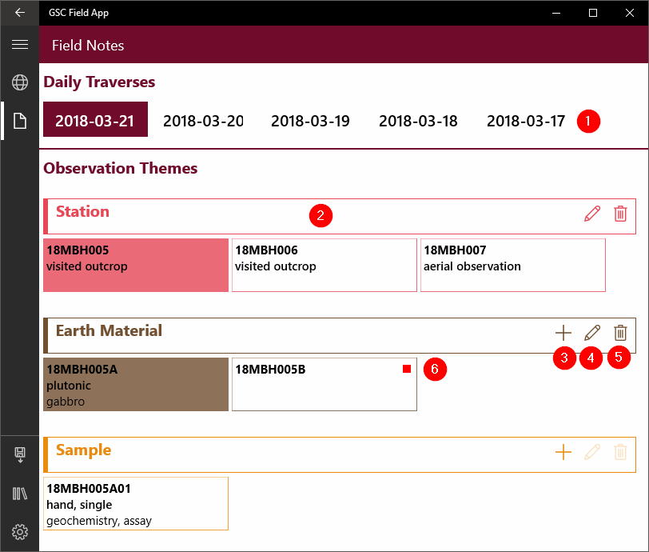
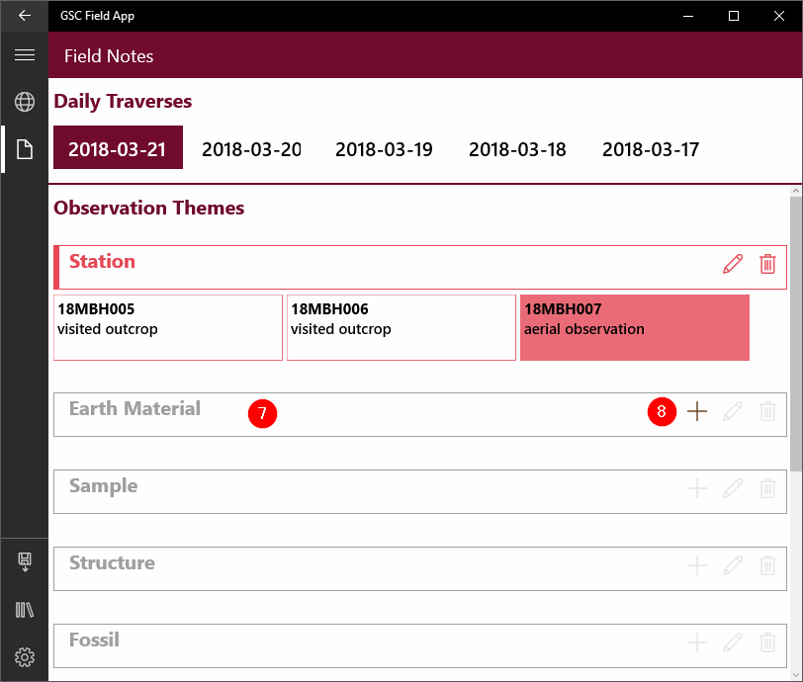
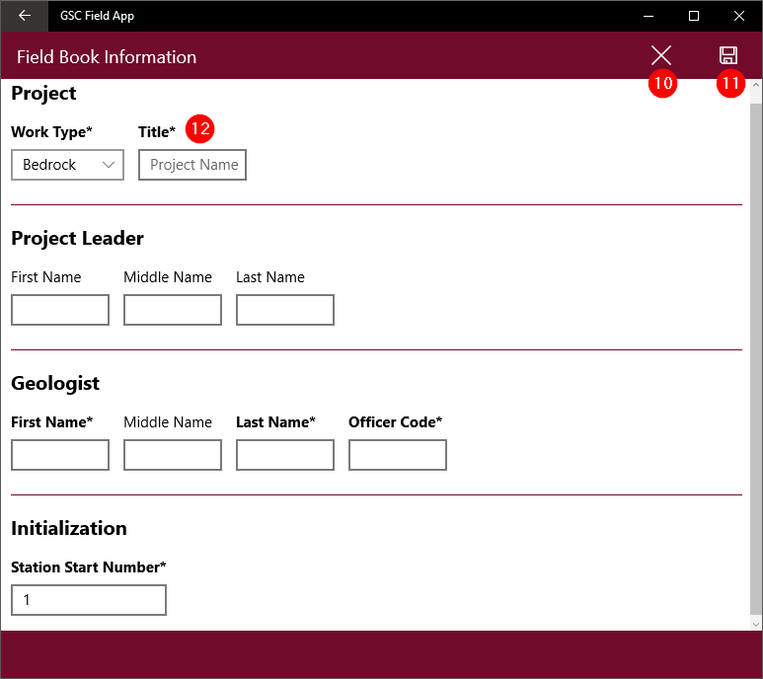
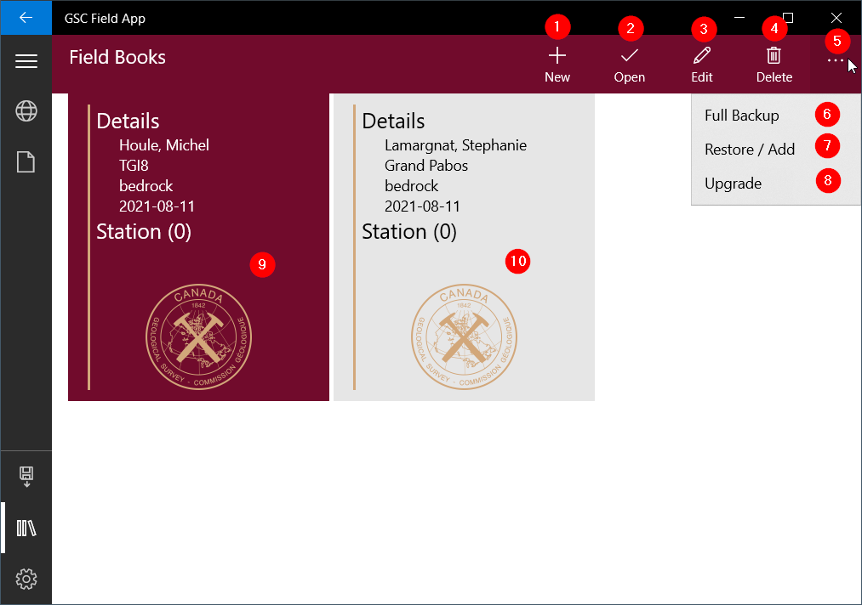
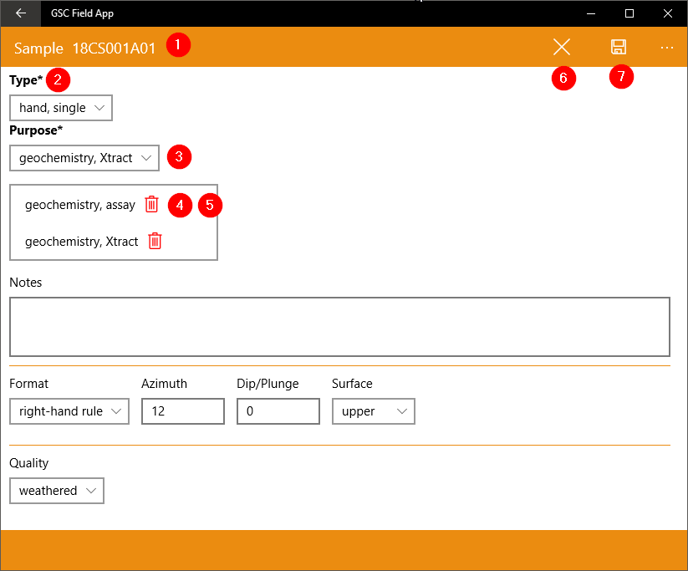
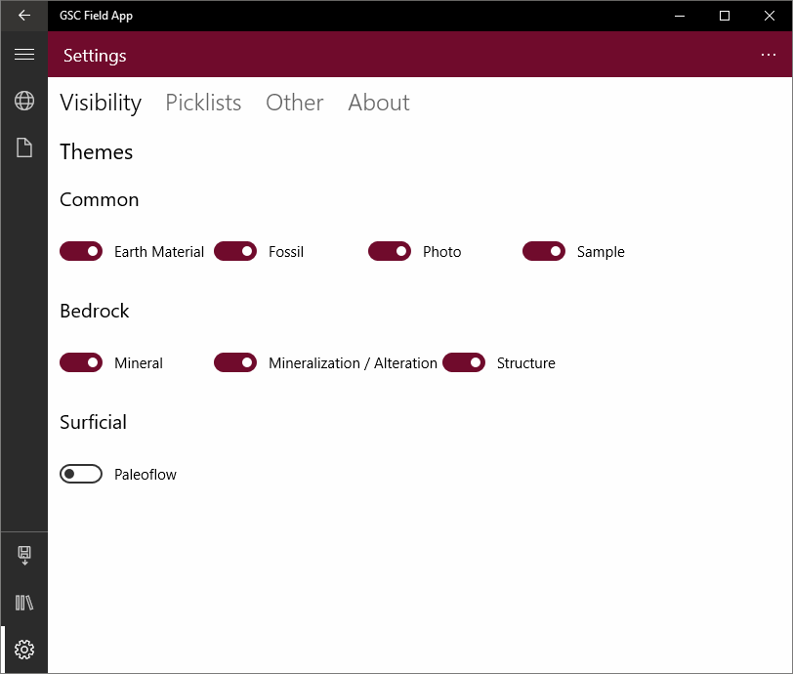
Field Notes page
Field Books page
Daily Traverses → List of record dates.
Click/tap on the date to update the content of the observation themes section for that date.
Observation Themes → List of records for the selected date. Available record types are Station, Earth Material, Sample, Structure, Fossil, Mineral, Mineralization/Alteration, Paleoflow, Photo and Location.
Theme bar: Displays the theme name. Clicking/tapping expands the list of records. Shrinking the header list of record can prevent scrolling down the entire list of records. Coloured header means there is at least one record available. A greyed header means no records are available.
Plus sign: Add a record to the selected theme if the icon is coloured. If the icon is grey, no record can be added.
Pencil: Opens an edit dialog for the selected record.
Trash can: Deletes the selected record with its related child records.
Red square: Indicates a record is missing mandatory fields. Mandatory fields are in bold and are followed by the * symbol in the edit dialogs.
Greyed out theme: There is no record available for the selected parent record.
Coloured icons: The button is active and a new child record can be added to the parent record.
Field book page header→ Quick tools to interact with field books. A device can manage many field books, enabling multiple users or projects. A field book contains a database, maps and photos taken by the device.
New: Creates a new field book.
Open: Opens a selected field book (refer to steps 8 and 9 below).
Edit: Opens the field book dialog to edit it’s metadata (i.e. geologist, project name, etc.).
Delete: Deletes a field book from the device. The GSC Field App will ask if you wish to make a backup of the field book in a backup location before it is deleted. An output zip archive contains database, maps and photos.
Ellipsis: Enable/disable top bar expansion, showing text icon and secondary options.
Full backup: Creates a zip archive containing the database, loaded maps and photos related to the active field book. The application asks for location to save the zip file.
Restore / Add: The application will ask for a zip archive file containing at least an SQLite database, and creates a new field book. Can also restore a full backup (refer to previous step 6) with database, maps and photos.
Upgrade: Will upgrade field book database schema to latest one.
Coloured field book: The currently active field book into which data are stored.
Greyed out field book: An inactive field book. Activate it by clicking/tapping on the Open icon (2).
Field books dialog → Tools to interact with map content.
Close/Exit: Closes the dialog without any save. Any modifications will be lost.
Save: Save changes made in the dialog and close the record.
Mandatory fields: Bolded and followed by the * character. A record can be saved even though mandatory fields are
not filled. A visual cue (coloured rectangle) will then appear in the field note page to remind you.
Theme dialogs
Alias ID: A concatenation of the year, geologist code, station number and, in this case, earth material A and sample number 1.
Mandatory fields: Bolded and followed by the * character. A record can be saved even though mandatory fields are not filled. A visual cue (coloured rectangle) will then appear in the field note page to remind you.
List of values: Available vocabulary for a chosen field. All of the drop-down lists can be edited in the picklist editor, available in the Settings page.
Multiple value fields: Box containing the value(s) selected in the previous step. Each value can be moved up or down the list and also deleted by a click/tap on the trash icon.
Close/Exit: Closes the dialog without any save. Any modifications will be lost.
Save: Saves changes made in the dialog and close the record.
Settings - Visibility
Visibility tab→ Settings for visibility with field notes page.
Themes: Set of switches that hides/shows theme bars in the field notes page. The current view is for a bedrock project. By default, if Surficial is selected, bedrock themes are hidden in field notes and surficial themes are visible.

